Slide 1
Accessibility Introduction
Dr. Andres Baravalle

Slide 2
Lecture content
Introduction to accessibility
Web accessibility
The WCAG initiative
Examples

Slide 3
Learning outcomes
This week we will be working on:
LO2: Apply appropriate design and specification standards
LO4: Effectively evaluate various systems and make appropriate design decisions

Slide 4
Introduction to accessibility

Slide 5
What is accessibility
“Accessibility is a general term used to describe the degree to which a product, device, service, or environment is accessible by as many people as possible” (Wikipedia)

Slide 6
ISO 16071 (2003)
Accessibility is the “usability of a product, service, environment or facility by people with the widest range of capabilities”

Slide 7
ISO 13407
"The usability of an interface is a measure of the effectiveness, efficiency and satisfaction with which specified users can achieve specified goals in a particular environment with that interface." (ISO 13407).

Slide 8
Accessibility and usability
Tying in usability’s definition (ISO 13407), we can say that:
"The accessibility of an interface is a measure of the effectiveness, efficiency and satisfaction with which people with the widest range of capabilities can achieve specified goals in a particular environment with that interface."

Slide 9
Accessibility and usability
If accessibility and usability are a measure, you have to be able to establish their magnitude, relative to a unit of measurement

Slide 10
Accessibility is about multiple paths (1)
An accessible artefact must support multiple paths to achieve the same task
For example, you (often) can use a mobile phone through voice recognition or using the hardware interface
An interface is accessible to an audience when there is at least one path which can be usable by each individual within the set of intended users

Slide 11
Accessibility is about multiple paths (2)
To ensure accessibility, interaction paths should be based on the characteristics of:
Users
Interfaces
Goals
A vocal interface to a hammer might not increase its accessibility
A vocal interface for a computer is likely to be more useful

Slide 12
Web accessibility

Slide 13
Web accessibility: introduction
The World Wide Web was conceived by Tim Berners Lee in a scientific environment and was intended to be used to exchange ideas freely among the scientific community.
The original form of the HyperText Markup Language (HTML), the language used to build web pages, provided structured documentation around headings, paragraphs and other structures that define the information content of a textual document.
Presentation was a secondary concern.

Slide 14
Web accessibility: introduction (2)
As the internet grew and access to computer networks widened, people other than scientists were able to access the Web and new professional figures, in charge of developing web pages, emerged.
The focus shifted a little from content towards presentation: web pages started to be more appealing and rich with graphics.

Slide 15
Focus on content vs. focus on presentation

Slide 16
Improving presentation with HTML 4.x
Widespread techniques include:
Proprietary, non-standard and browser-specific extensions to the HTML standard, for adding formatting properties (e.g. the tags <wbr> and <nobr>)
Using images (with a wider font selection) for rendering text to replace plain text on the page
Using images to create graphical elements for presentation, such as ‘fancy’ borders around the page
Using data tables for page layout structures, often with blank images to control the white space
Using plugins or scripting to produce additional effects not provided by HTML

Slide 17
Consequences (some examples)
Inconsistencies amongst browsers: due to the use of proprietary tags, different browsers could be showing the content quite differently
Accessibility was strongly affected by the unexpected use of HTML tags. HTML tags carry a semantic meaning: <h1> for example, refers to a page heading, and should not be used just to make text bigger.
Using tables for layout, or images for borders, was overloading the tags with functions that they didn’t originally have.

Slide 18
Disabilities that can affect web access (non-exaustive list)
Hearing disabilities (people who are deaf, hard of hearing, or hearing impaired)
Visual disabilities (people who are blind, colour-blind or visually impaired)
Mobility disabilities (people who are physically disabled or with impaired motor skills)
Learning disabilities (such as people with dyslexia).
It has been estimated that between 15% and 30% of world population, and almost 10% of internet users, has some kind of disability

Slide 19
That was wrong!
A series of “magic numbers” - numbers that appeared by “magic” - were used in the previous slide
Never forget to include appropriate references and support your statements with relevant quotes
Thatcher, J., Waddell, C., Henry, S., Swierenga, S., Urban, M., Burks, M. and Bohman, P. (2003) Constructing Accessible Websites, Apress, chapter 1.

Slide 20
Why web accessibility is so important
As the Web displaces more traditional information sources and becomes a key resource for information, commerce, entertainment, distance learning, job searching and government services, it becomes more important that everyone has access to it.

Slide 21
Making the web accessible
Accessible websites and Web applications, where people with disabilities can perceive, understand, navigate, and interact
Accessible user-agents, such as Web browsers and Web applications in general (such as rich media players), that can be used effectively by people with disabilities, and that work well with assistive technologies that some people with disabilities use to access the Web
Accessible Web authoring tools, which support the production of accessible Web content and websites, and that can be used effectively by people with disabilities.

Slide 22
The WCAG initiative

Slide 23
WCAG guidelines
The Web Content Accessibility Guidelines have been compiled by the Web Accessibility Initiative project (WAI - W3C) to explain how to make web content accessible

Slide 24
WCAG guidelines: #1
Provide equivalent alternatives to auditory and visual content.

Slide 25
WCAG guidelines: #2
Don't rely on color alone

Slide 26
WCAG guidelines: #3
Use markup and style sheets and do so properly

Slide 27
WCAG guidelines: #4
Clarify natural language usage

Slide 28
WCAG guidelines: #5
Create tables that transform gracefully

Slide 29
WCAG guidelines: #6
Ensure that pages featuring new technologies transform gracefully

Slide 30
WCAG guidelines: #7
Ensure user control of time-sensitive content changes

Slide 31
WCAG guidelines: #8
Ensure direct accessibility of embedded user interfaces

Slide 32
WCAG guidelines: #9
Design for device-independence

Slide 33
WCAG guidelines: #10
Use interim solutions

Slide 34
WCAG guidelines: #11
Use W3C technologies and guidelines

Slide 35
WCAG guidelines: #12
Provide context and orientation information

Slide 36
WCAG guidelines: #13
Provide clear navigation mechanisms

Slide 37
WCAG guidelines: #14
Ensure that documents are clear and simple

Slide 38
Examples

Slide 39
Examples
The next examples are for discussion
Which ones are usable?
Which ones are accessbile?
WHY?

Slide 40
Example 1: CAPTCHAs
CAPTCHAs are commonly used as a countermeasure to the action of robots, software that crawls the Web to gather information or to post content.
CAPTCHAs, used together with an authentication system, (should) ensure that robots can’t post content or access some areas of a website.

Slide 41
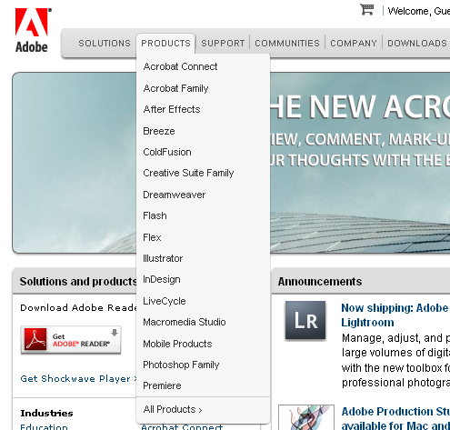
Example 2: Drop-down menu at Adobe.com

Slide 42
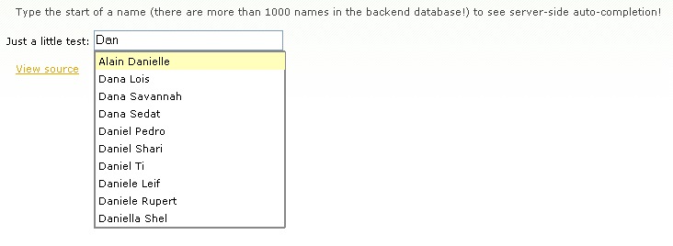
Example 3: auto-completion at script.aculo.us

Slide 43
Example 4: Mojo
<div dojoType="dijit.layout.BorderContainer" design="sidebar" liveSplitters="false">
<div dojoType="dijit.layout.ContentPane" region="leading">
<div id="feature-menu"> <div class="cp" id="DojoLinkPane"> <div class="cpContent"> <div dojoType="dojoc.sandbox.menu.AccordionMenu" id="DojoMenu" store="navStore" init="Dojo [...]
(see http://dojocampus.org/explorer/#Dojox_Image_Lightbox_Grouped)

Slide 44
Example 5: script.aculo.us
<div class="c">
<div class="example" id="demo-effect-blinddown" onclick="new Effect.BlindDown(this)"> <div style="height: 120px;"> <img src="http://script.aculo.us/images/demo-logo.gif" alt="">
<span>Click for Effect.BlindDown demo</span> </div> [...]
(see http://wiki.github.com/madrobby/scriptaculous/combination-effects-demo)

Slide 45
Testing tools
The web developer toolbar:
WCAG test
No stylesheets
Hide images
Validate HTML/CSS
Lynx!

Slide 46
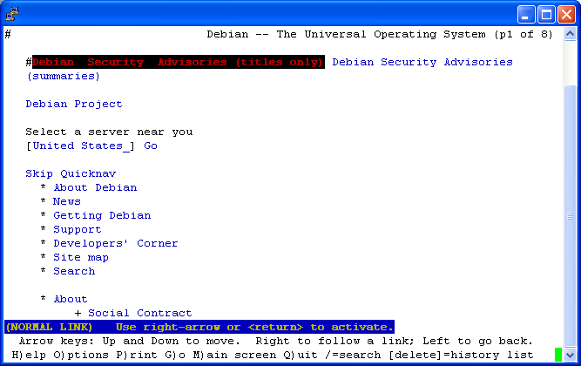
Lynx

Slide 47
Readings
The WCAG (Web Accessibility Initiative) website: http://www.w3.org/WAI/
Web Content Accessibility Guidelines 1.0 http://www.w3.org/TR/WCAG10/
Web Content Accessibility Guidelines 2.0: http://www.w3.org/TR/WCAG20/
Checklist of Checkpoints for Web Content Accessibility Guidelines 1.0: http://www.w3.org/TR/WCAG10/full-checklist.html

